Slide 1
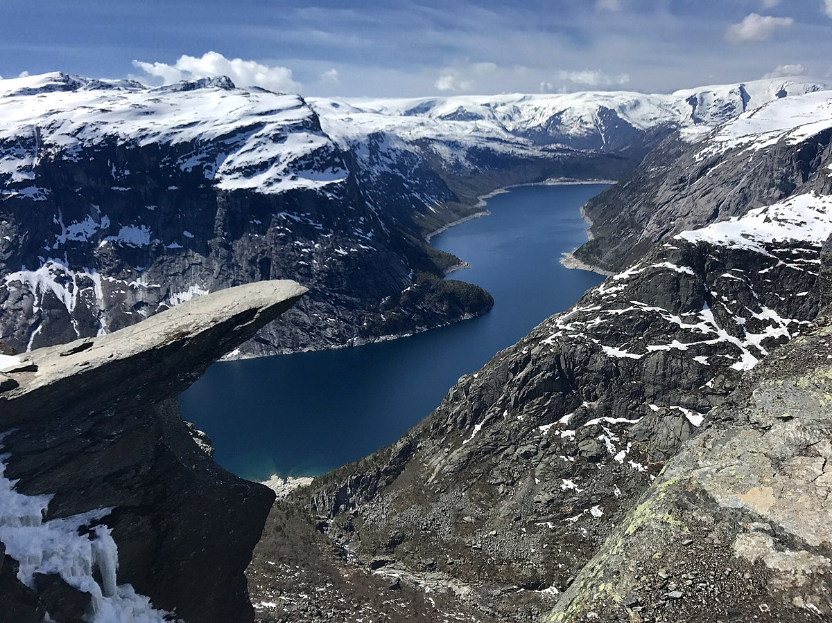
Scandinavia
By Evan.C And Alex.C

Slide 2
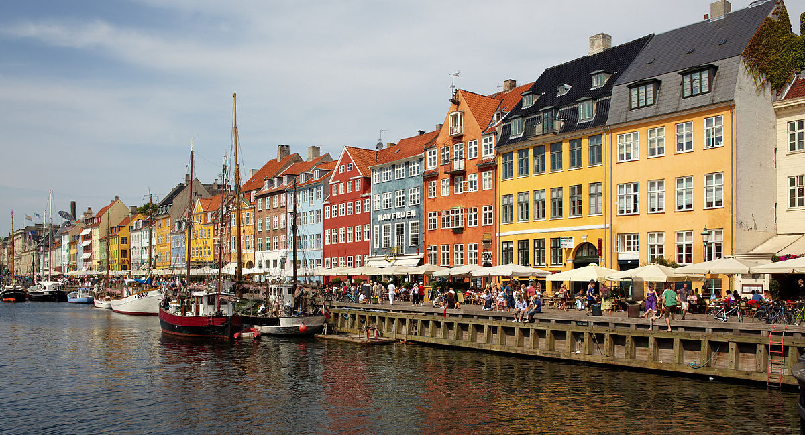
What is Scandinavia?
Scandinavia is made up of Norway, Sweden and Denmark.
In the summer, for 2 months, the sun never sets.
In the winter, for 2 months, the sun never rises. Weird right?
Now, lets break down the countries!

Slide 3
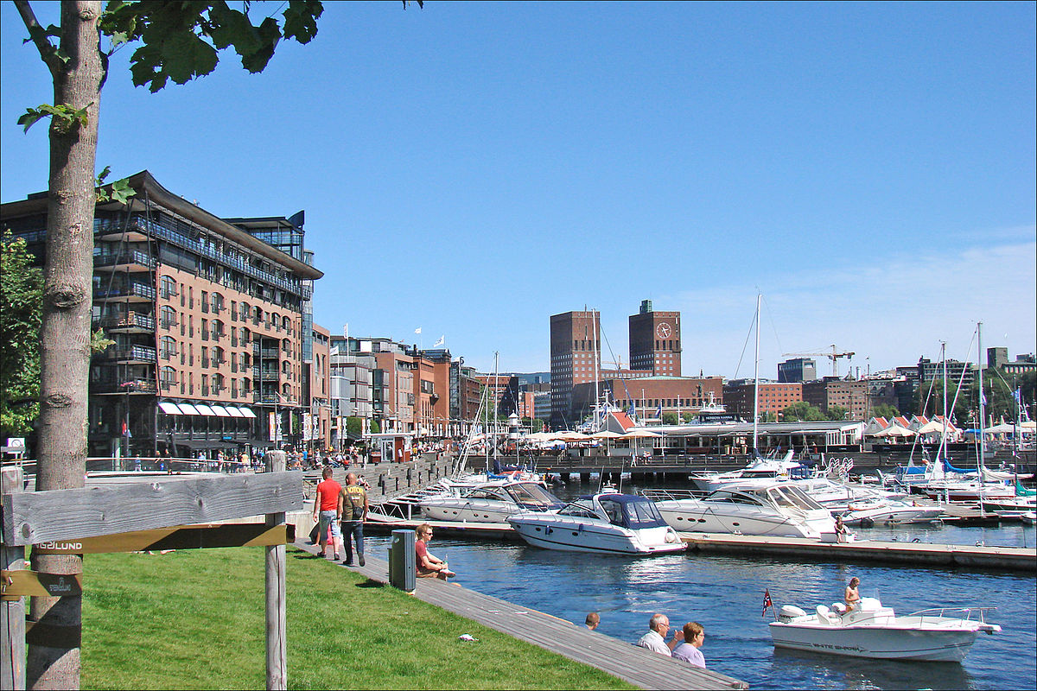
Norway
Population:5.1 million
Language: Norwegian
Currency: Norwegian krona
Religion: Mainly Christian
Famous peeps: Edvard munch

Slide 4
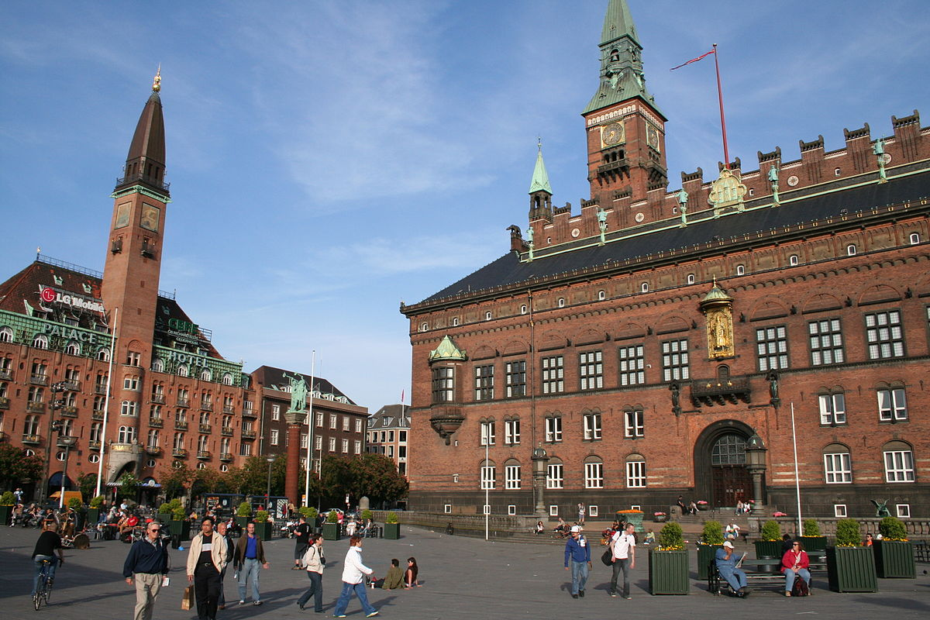
Denmark
Population: 5.7 million
Currency: Danish Krone
Religion: Christianity
Language: Danish
Famous people: Christian Eriksen; Footballer

Slide 5
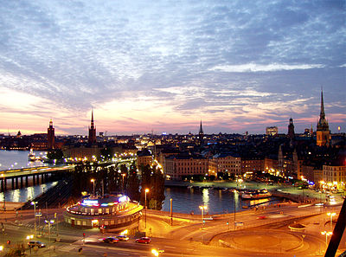
Sweden
    Languages: Swedish, Finnish, Yiddish and Romani
    Religion: Christian Population: over 10 million
    Famous peeps: ZLATAN DA GOD; footballer/ GOD

Slide 6

The End!
Hope u enjoyed :D

