Slide 1
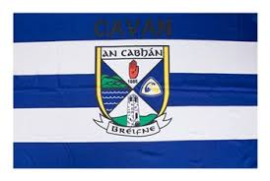
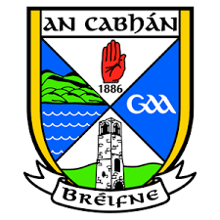
CAVAN
By Caelan Innes

Slide 2
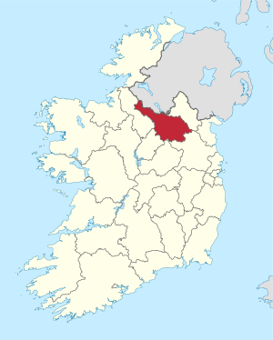
CAVAN GAA
Cavan is in Ulster.
Cavan inter county teams play in the Ulster championship.
Cavan inter county teams play at all levels, men and women.
Cavan have won a record 39 Ulster Senior Football Championship titles.
Cavan have won the All-Ireland Senior Football Championship 5 times, the first time in 1933 and the last time in 1952.
Cavan are the only GAA team to win an All-Ireland outside of Ireland in the Polo Grounds in New York in 1947.

Slide 3
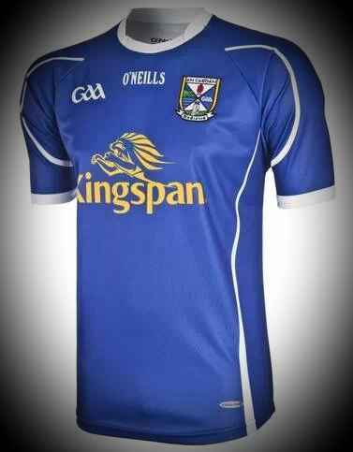
CAVAN GAA FACTS
The Cavan inter-county teams wear blue jerseys and white shorts.
The Irish name for Cavan is “An Cabhán” and the GAA team are known as the “Breiffni Blues”.
Cavan’s county grounds are in Cavan town and are called Kingspan Breiffni Park.
The Ulster Championship cup is called “The Anglo Celt Cup” – named after the local Cavan newspaper.

Slide 4
CAVAN GAA FACTS
In 2004 Cavan released a new crest for the Breifne County. The crest was designed by the 38th President of the GAA of the Aogán Farrell.
The crest includes the red hand of Ulster and includes pictures of the landscape – hills & lakes.
The primary colours in the crest are blue and white.

Slide 5
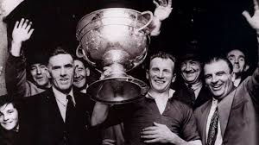
CAVAN GAA Clubs & Players
The first GAA club in the province of Ulster was formed in Cavan – Ballyconnell First Ulsters.
Other clubs within the County include, Cavan Gaels, Bailieboro Shamrocks, Drumgoon Éire Óg, Kingscourt Stars and Mullahoran.
Some famous Cavan players include – John Joe O’Reilly, Mick Higgins, Stephen King, Dermot McCabe, Lauren Fitzpatrick and Rachel Doonan.
John Joe O’Reilly
Lauren Fitzpatrick

Slide 6
THANK YOU

